Slide 1
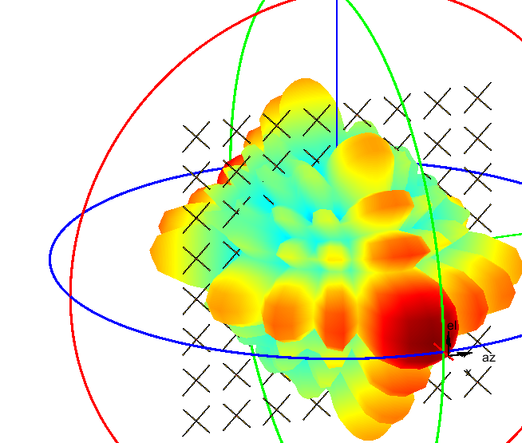
Hands on Workshop:
Getting Started with RF Design of Wireless Systems

Slide 2
Agenda
Use a practical example to understand the basics of analysis and simulation technology
Analyze the RF budget of a receiver starting from high-level specifications
Integrate the antenna and simulate the impact of interfering signals and polarization mismatch
Design a dual polarized antenna and its feed network on a PCB and integrate it in the receiver
Expected learning outcomes:
Validate simulation results using different RF analysis tools
Integrate datasheet specifications and measured data to improve modeling fidelity
Create executable models from antenna to bits including: dispersion, impedance mismatches, coupling, polarization, non-linearity, noise, interferers

Slide 3

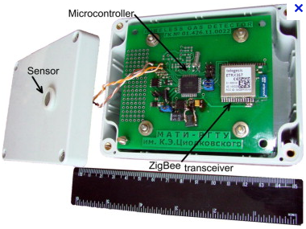

Practical Example: Design of a ZigBee Receiver Using RF Components
Start from the system specifications and build an executable model
Explore the architecture, refine the RF front-end design, integrate the antenna
Validate the system behavior in presence of interfering signals
?
https://www.mathworks.com/help/simrf/ug/top-down-design-of-an-rf-receiver.html

Slide 4
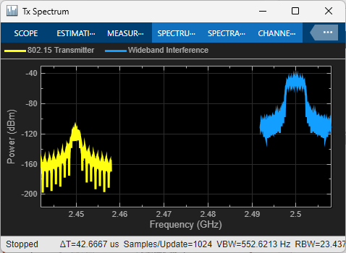
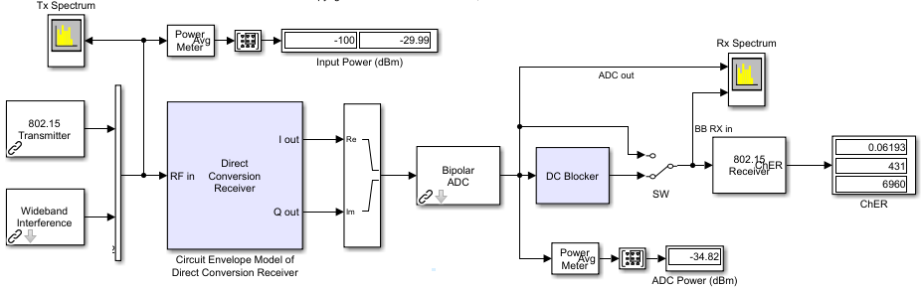
Reference Testbench: Baseband Signal Processing + RF Receiver
Desired Signal
@2.45GHz
DC offset correction
ADC placeholder
Interfering Signal
@2.5GHz
Baseband receiver
ChER measurement
Direct conversion
RF receiver

Slide 5
Part 1: RF Design – Where To Start? RF Budget Analysis

Slide 6
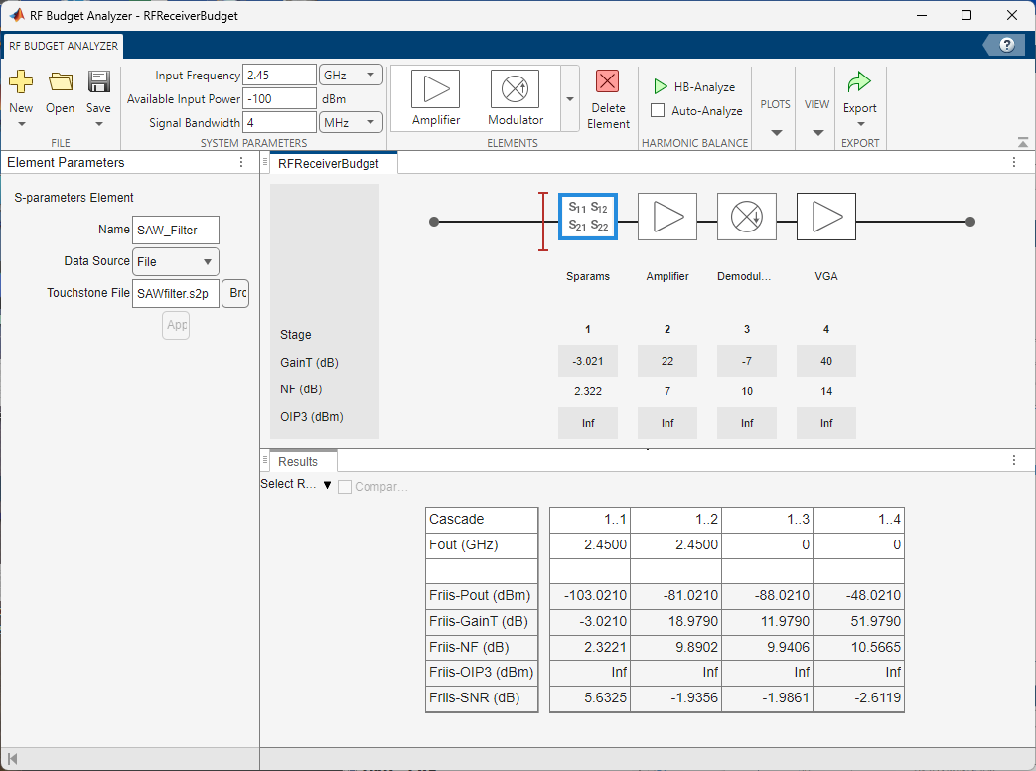
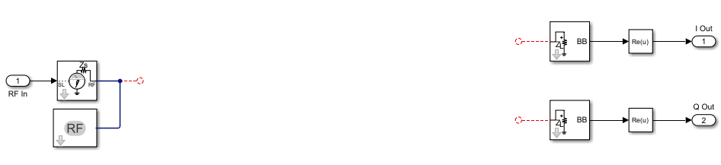
Exercise 1: RF Budget Design, Analysis, and Integration
1. RF chain budget analysis
2. RF architectural model
3. RF system integration and simulation
non-linearity, noise, and interfering signals

Slide 7
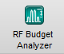
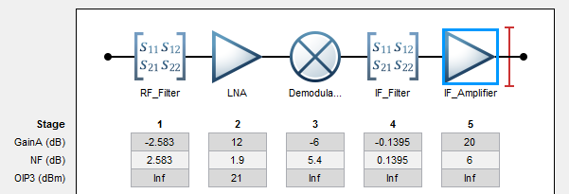
RF Design – Where To Start?
RF Budget Analyzer App
Compute and visualize power/noise/IP3 RF budget with Friis and Harmonic Balance
Improve over spreadsheet analysis: account for impedance mismatch and high-order nonlinearity
Generate MATLAB scripts for automation and complex scenario analysis
Generate Circuit Envelope models/testbenches for simulation and system integration
Notes:
$$F_{total}=F_{1}+\frac{F_{2}−1}{G_{1}}+ \frac{F_{3}−1}{G_{1}G_{2}}+\frac{F_{4}−1}{G_{1}G_{2}G_{3}}+ …+\frac{F_{n}−1}{G_{1}G_{2}{…G}_{n−1}}$$
$$\frac{1}{{OIPN}_{total}}=\frac{1}{{OIPN}_{1}}+ \frac{G_{2}}{{OIPN}_{2}}+\frac{G_{2}G_{3}}{{OIPN}_{3}}$$

Slide 8
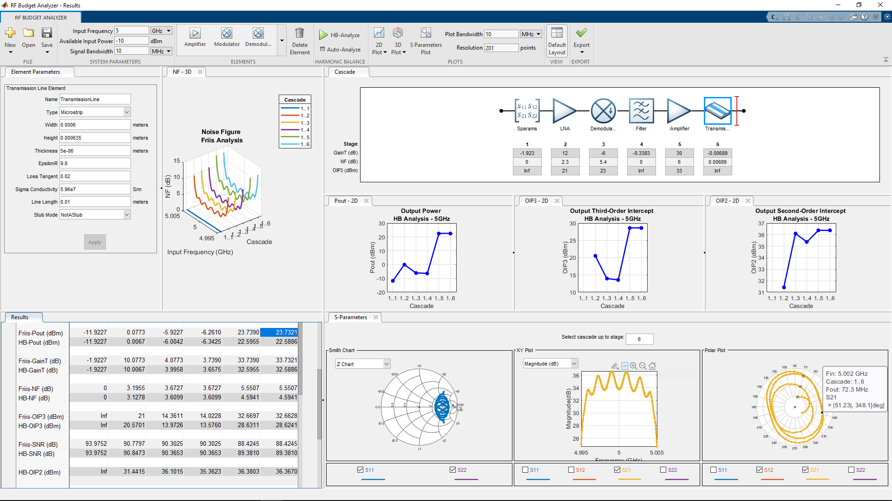
Analyze, Understand, and Debug RF Data and RF Budget
System specifications
RF components
Harmonic Balance (non-linear) analysis
Export to MATLAB / RF Blockset
Visualization
Cascaded Budget Analysis (Friis and Harmonic Balance)
Notes:
You can describe any arbitrary RF chains for transmitter and receivers, and identify the most critical components by analysing the noise and power budget.

Slide 9
Exercise 1

Slide 10
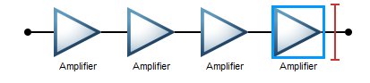
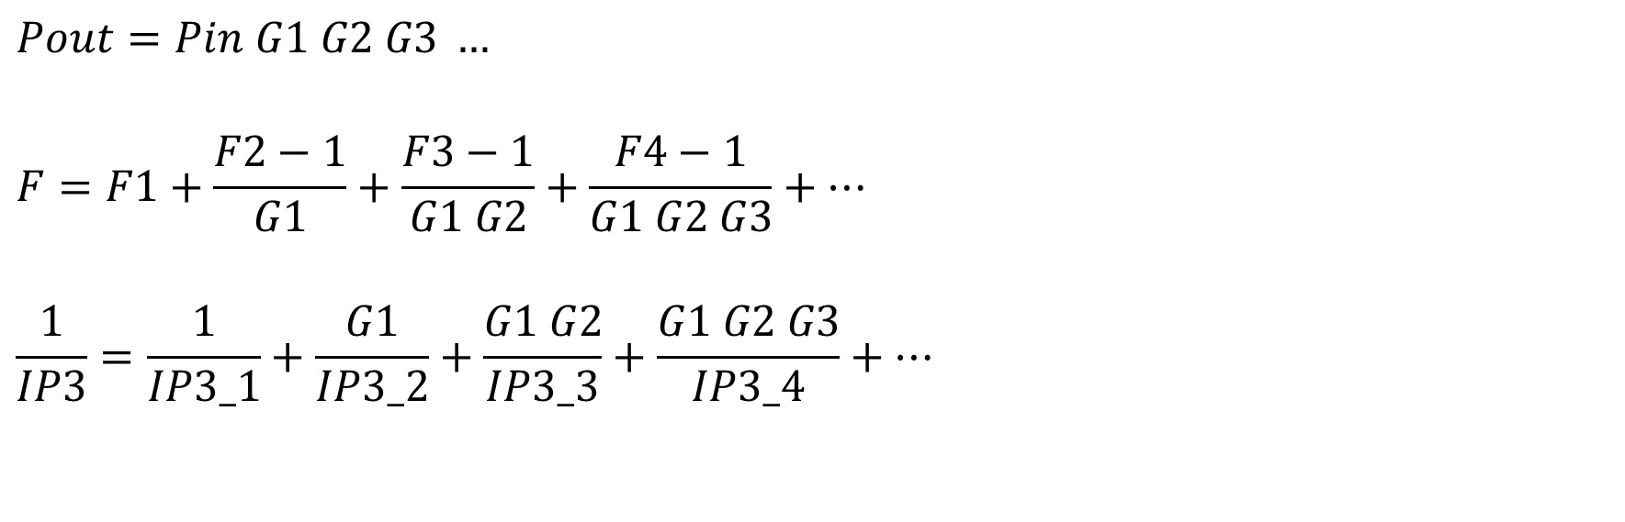
Friis Formulas, Deceptively Easy!
$$Pout=Pin G1 G2 G3 …$$
$$F=F1+\frac{F2−1}{G1}+\frac{F3−1}{G1 G2}+\frac{F4−1}{G1 G2 G3}+…$$
$$\frac{1}{IP3}=\frac{1}{IP3_1}+\frac{G1}{IP3_2}+\frac{G1 G2}{IP3_3}+\frac{G1 G2 G3}{IP3_4}+…$$
G1
F1
IP3_1
G2
F2
IP3_2
G3
F3
IP3_3
G4
F4
IP3_4
What about impedance mismatches?
What happens with modulators/demodulator?
What happens if one of the stages is close to saturation?
What happens to second order nonlinearity?
Notes:
These are Friis formulas.
According to Friis every RF components can be treated like an amplifier, and if the operating range is mildly nonlinear then everything works fine.
These formulas are often implemented in Excel spreadsheet, and have often major limitations.
For example, what happens to impedance mismatches, or what happens to components that change the signal frequency, like modulators, or to effects that generate harmonics out of band? These are hard questions to answer with these ideal formulas.

Slide 11
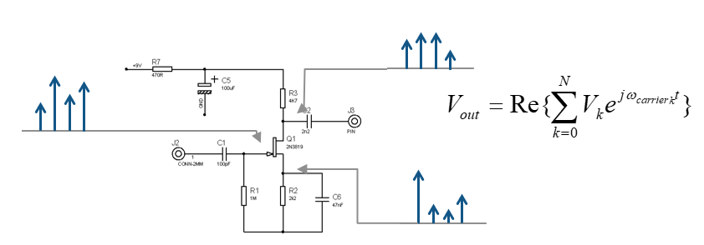
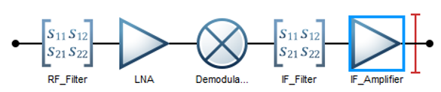
What is Harmonic Balance?
Accurate non-linear analysis
Sinusoidal tones
Steady state conditions
Mild non-linear circuits
Now available in RF Budget Analyzer app
Foundation of RF Blockset Circuit Envelope simulation
Notes:
Harmonic balance is an analysis technique used to improve the accuracy of RF analysis.
It is based on a few sinusoidal tones, and operates only in steady state conditions. Ofrget about using HB with feedback loops and adaptive systems!
Major analysis tool of Keysight ADS used for RF design at the transistor levele, where time domain simulation or even circuit envelope is too time consuming.
Easy to include linear frequency-defined components
S-parameters, distributed elements (microstrips, coplanar waveguides, …)
Good for (mildly) non-linear circuits
Complexity increases exponentially with the number of independent input tones
Before adding HB in the app, results were only computed with Fris.
This means that now results are more accurate, and it opens up fir further improvements along the way.

Slide 12
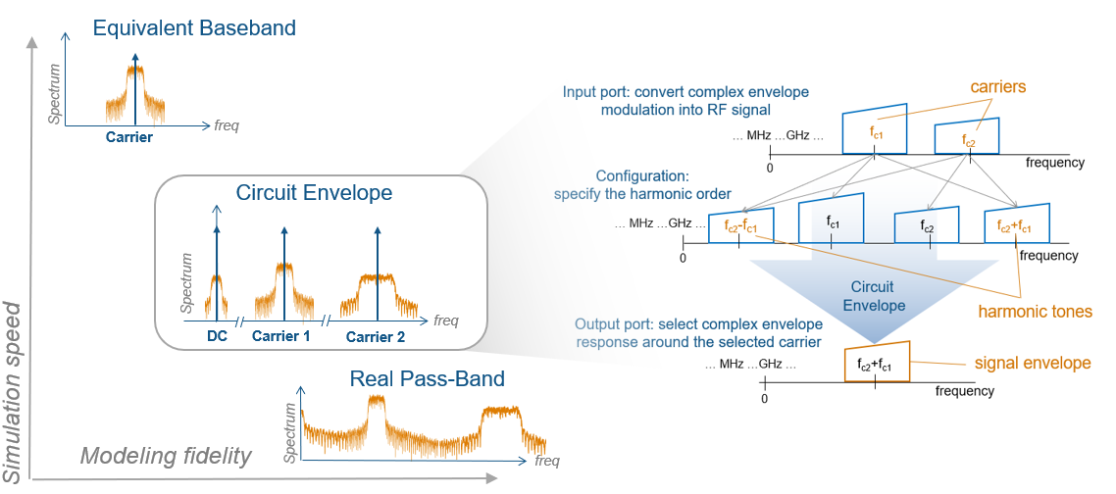
Tradeoff Modeling Fidelity and Simulation Speed
Models at high levels of abstraction
Solvers that use larger time-step

Slide 13
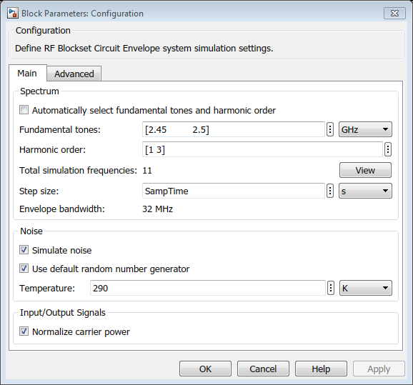
Control the Simulation Set-Up and Complexity
Envelope bandwidth = 1 / time step
Spectrum
DC
Freq 1
Freq 2
freq
Number of mixing products
depends on harmonic order

Slide 14
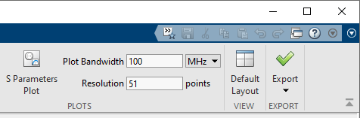
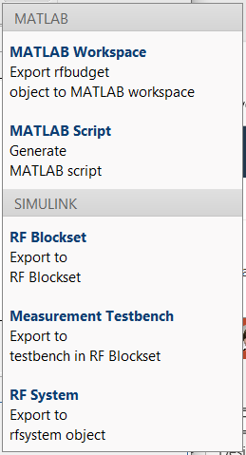
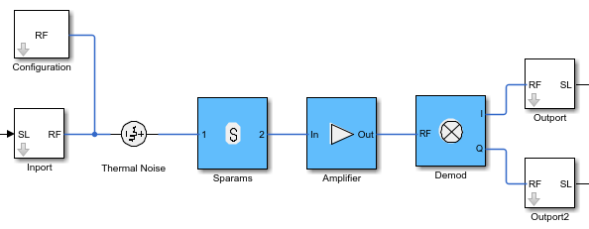
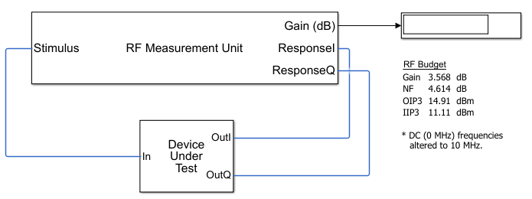
Export from RF Budget Analyzer
MATLAB workspace object
Bidirectional workflow between app and command line
MATLAB script
Automate corner analysis and chain optimization
RF Blockset
Generate model for Circuit Envelope simulation
Automatic configuration of Input/output ports
Measurement testbench
Measure gain, noise, IP3, IP2, DC offset, and image rejection
rfsystem
Integrate RF model directly in MATLAB for simulation

Slide 15
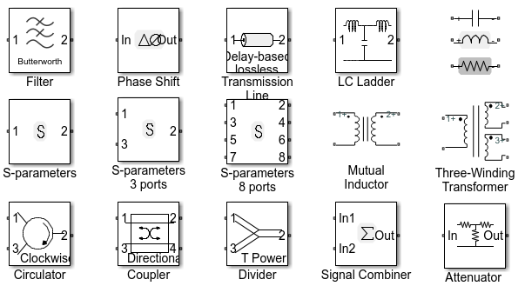
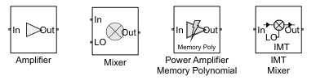
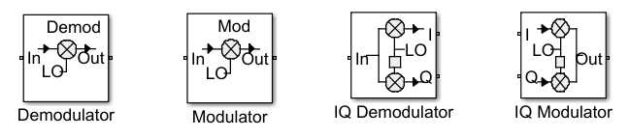
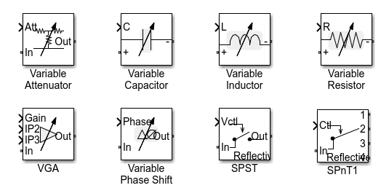
Circuit Envelope Available Blocks
Frequency dependent (linear) elements
S-parameters, antenna, filter, attenuator, coupler, circulator, divider/combiner, phase shifter, RLC, transmission lines
Nonlinear elements
Amplifier: polynomial, generalized memory poly, AM/AM-AM/PM table
Mixer: polynomial, IM table, and complete modulator/demodulators
Noise generation included for linear and non-linear elements
Thermal noise (white and colored)
Phase noise
Variable (Simulink controlled) elements for tunable networks
Non-linear variable gain amplifier, variable attenuator, bidirectional variable phase shifter, variable RLC

Slide 16
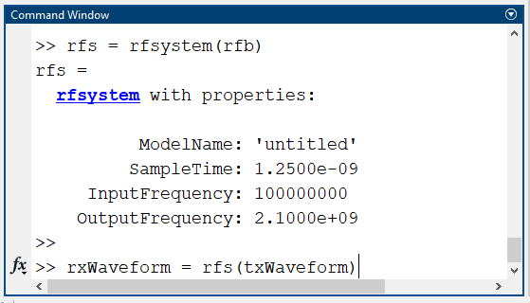
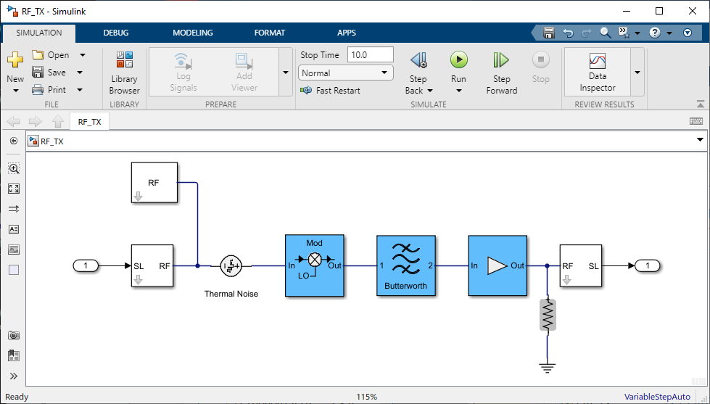
When to Use MATLAB, When To Use Simulink? Use rfsystem to wrap an RF Circuit Envelope model for simulation in MATLAB
Create rfsystem object
from budget analysis
Use Circuit Envelope model as part of a MATLAB testbench

Slide 17
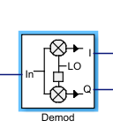
Direct Conversion Demodulation
Channel select filter
Desired signal
Desired signal
frequency
2.45GHz
0Hz
frequency
2.45GHz
Local Oscillator

Slide 18
Direct Conversion Demodulation and Reciprocal Mixing
Channel select filter
Local Oscillator self-mixing
Local Oscillator leakage
Desired signal
frequency
2.45GHz
0Hz
frequency
Desired signal
Finite isolation
2.45GHz
Local Oscillator

Slide 19
Direct Conversion Demodulation and Interfering Signals
Channel select filter
Interfering signal
Desired signal
Desired signal
frequency
2.45GHz
2.5GHz
0Hz
frequency
50MHz
Interfering signal
2.45GHz
Local Oscillator

Slide 20
Direct Conversion Demodulation and Interfering Signals
Channel select filter
Interfering signal
Finite IP2
Desired signal
Desired signal
frequency
2.45GHz
2.5GHz
0Hz
frequency
Interfering signal
2nd order harmonic
50MHz
Interfering signal
2.45GHz
Local Oscillator

Slide 21
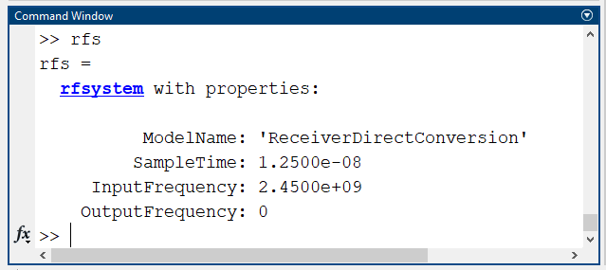
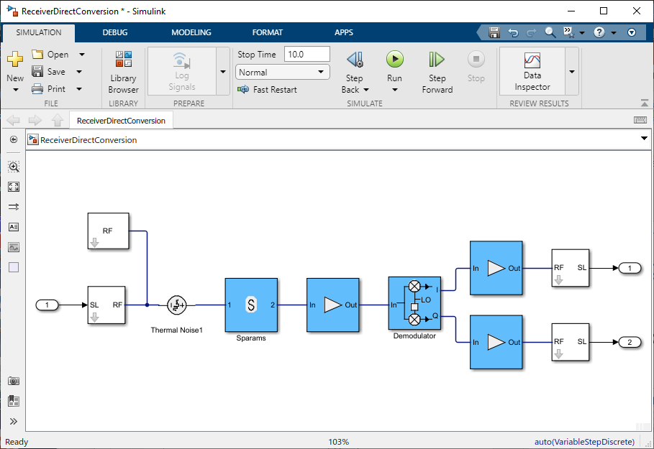
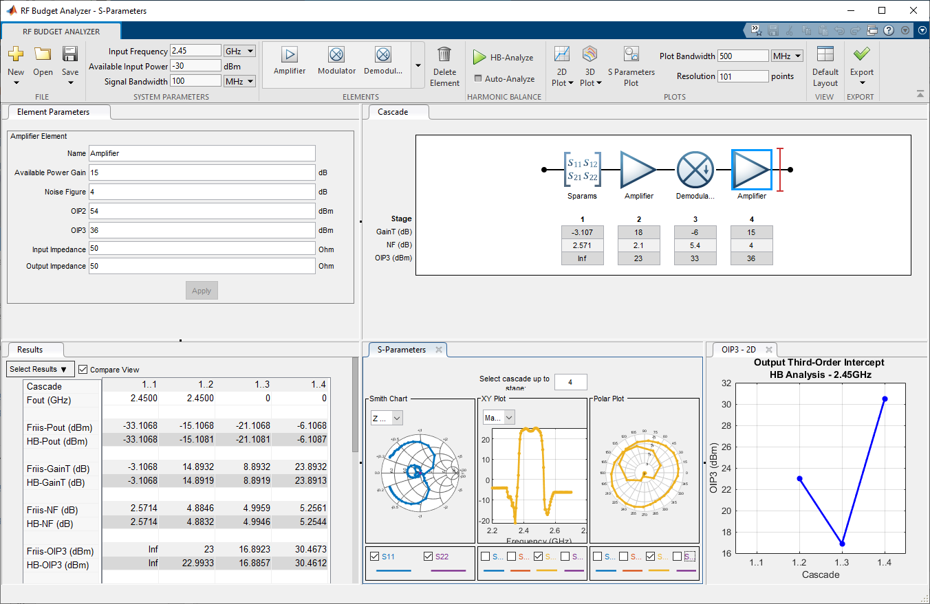
Using rfsystem: Direct Conversion
>> [I, Q] = rfs(input)

Slide 22
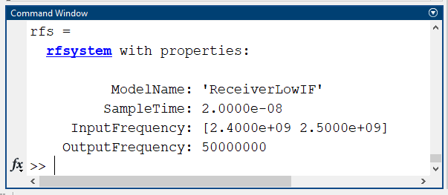
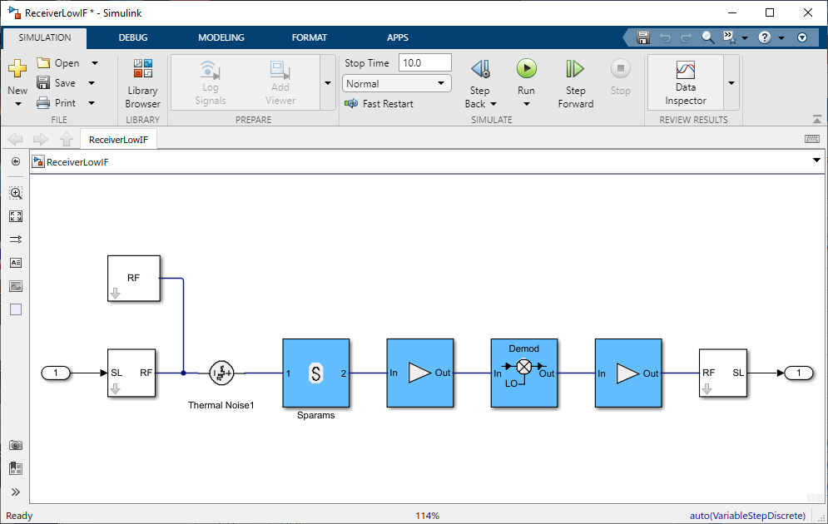
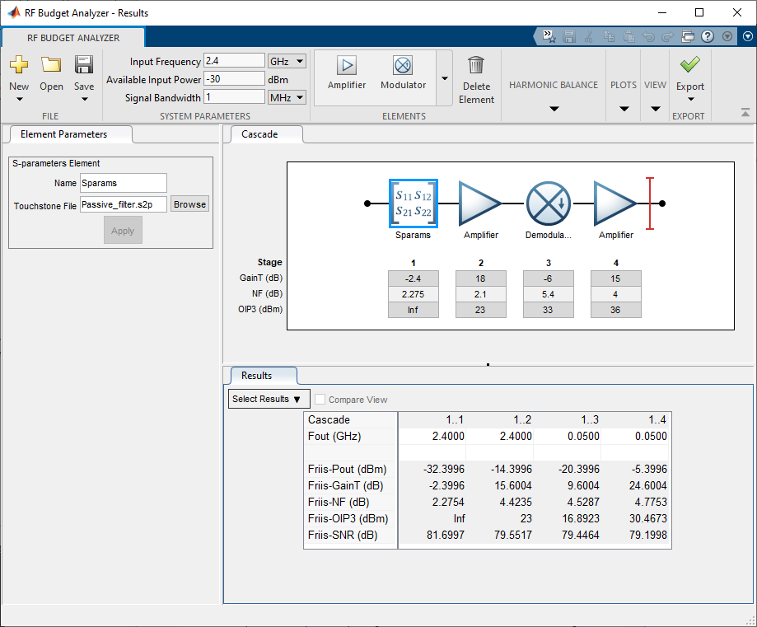
Using rfsystem: Multi-Carrier Simulation
LO = 2.45GHz
>> out = rfs([input image])

Slide 23
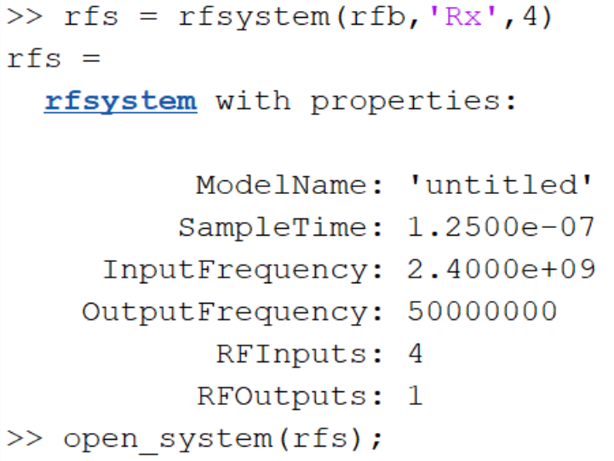
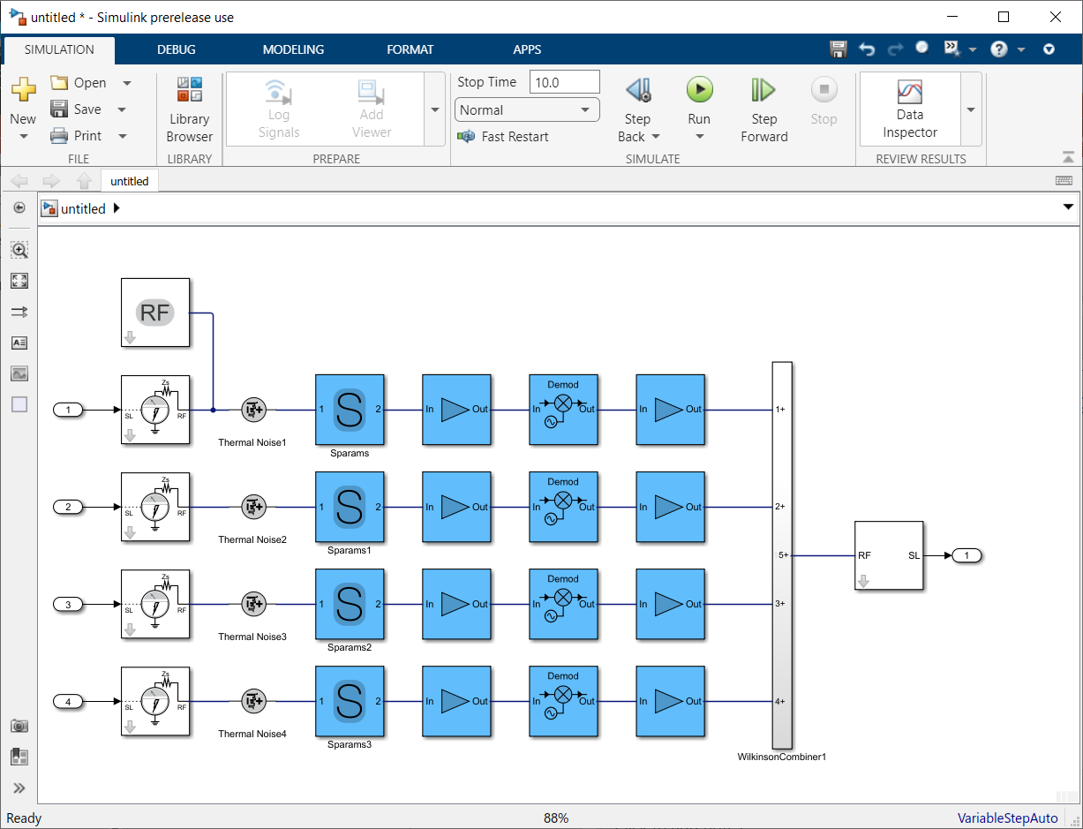
Using rfsystem: MIMO System Modeling
Automatically generate MIMO systems from a single budget chain
Suitable for transmitters and receivers
Extend with antenna and array block if needed

Slide 24
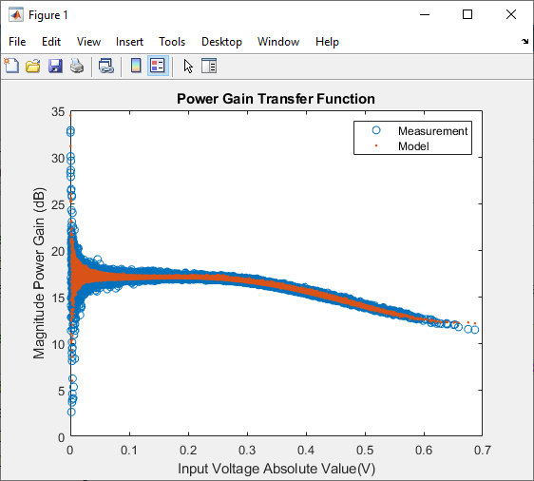
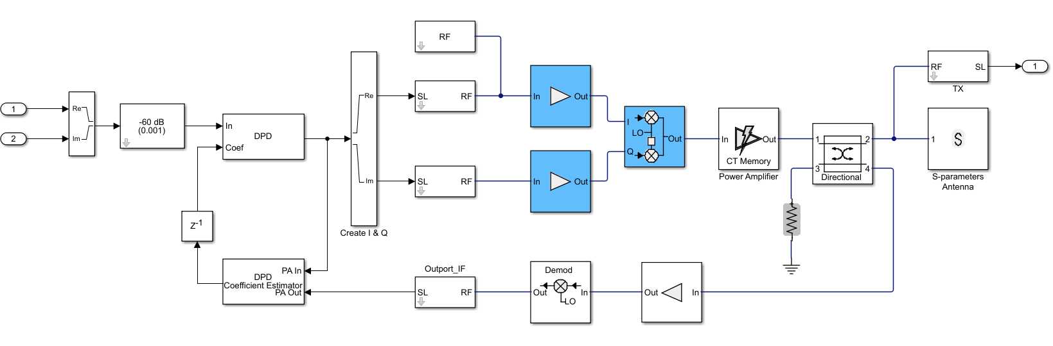
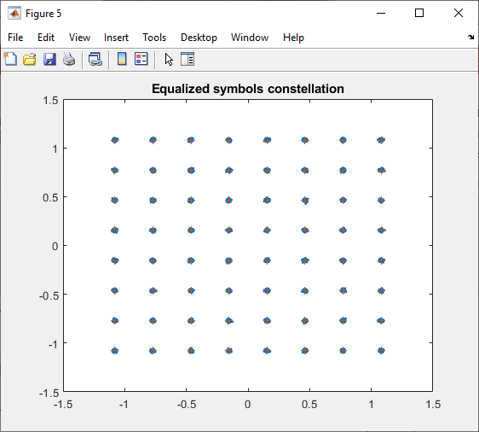
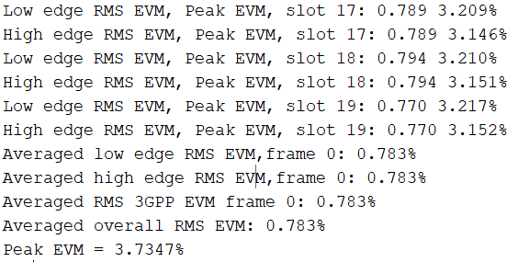
Further Elaborate the Simulink Model to Model Your Architecture
>> out = rfDPD(I, Q)

Slide 25
Part 2: Antenna Design and Analysis - Where to Start? Estimating the Impact of Antennas on Your System Performance

Slide 26
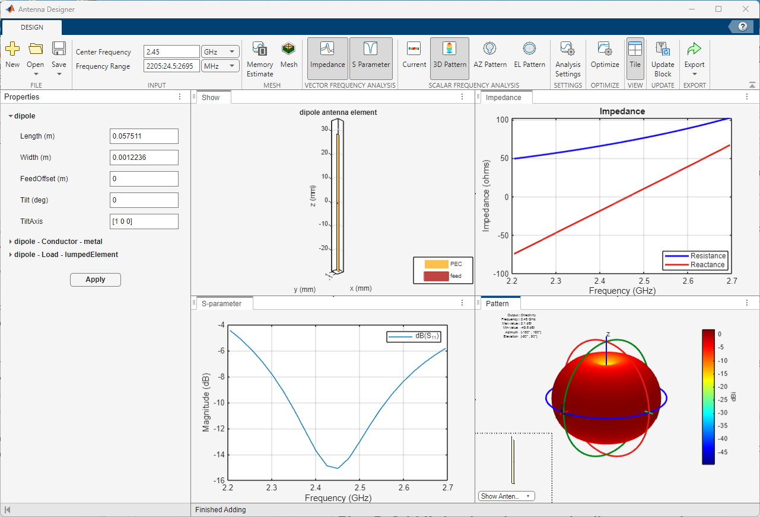
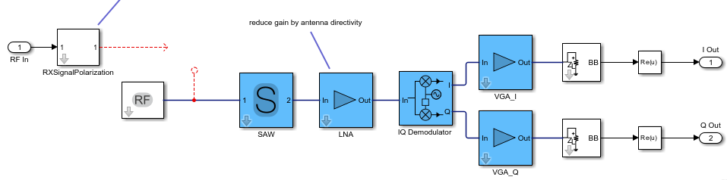
Exercise 2: Antenna Design, Analysis, and Integration
1. Antenna analysis
2. RF architectural model
3. Antenna integration:
impendance, directivity, polarization

Slide 27
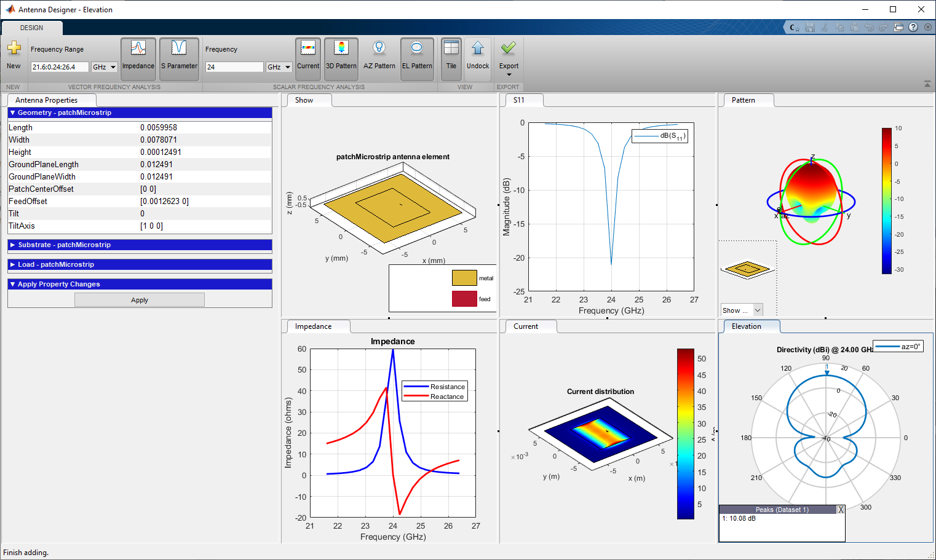
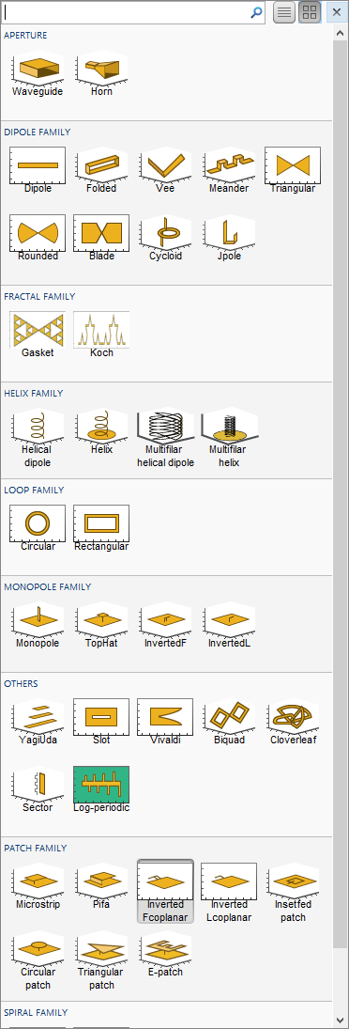
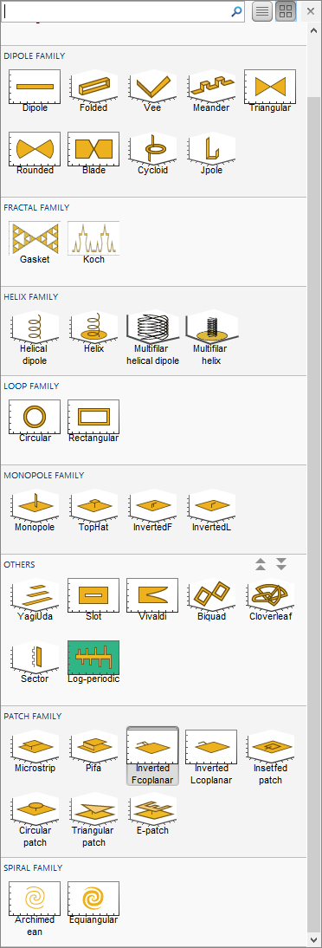
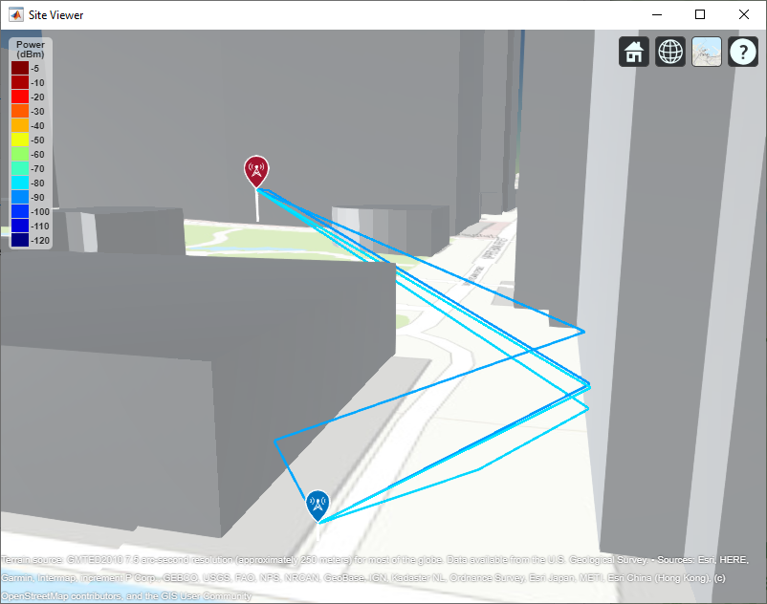
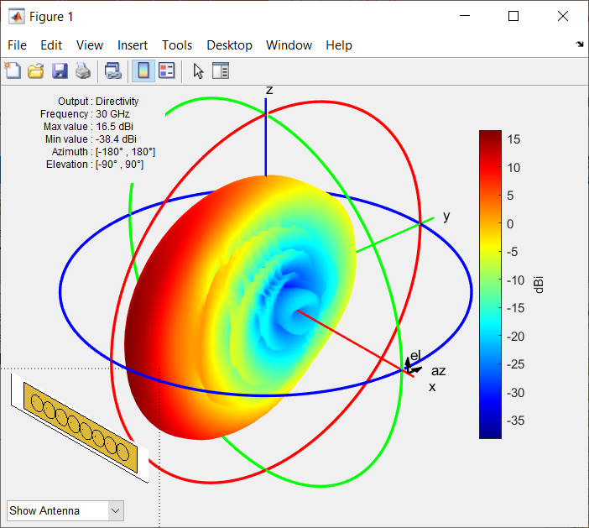
Design, Analyze, and Visualize Antennas
Get started with antenna and array catalog and apps
Perform full-wave EM simulation (Method of Moments)
Improve the performance using surrogate optimization
Design and fabricate PCBs with Gerber file generation
Analyze the effects of installation on large platforms
Include RF propagation effects
Notes:
Antenna Toolbox offers a lot more than what discussed today, such as surrogate optimization, PCB design, installation of antennas on platforms and the analysis of propagation effects.

Slide 28
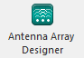
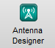
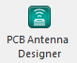
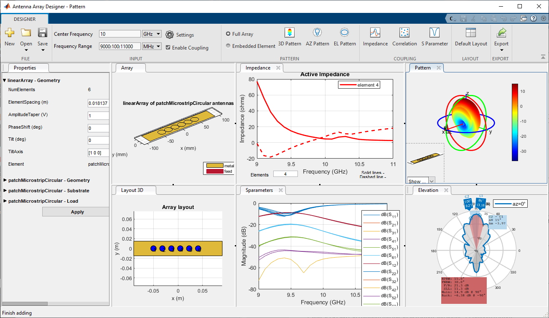
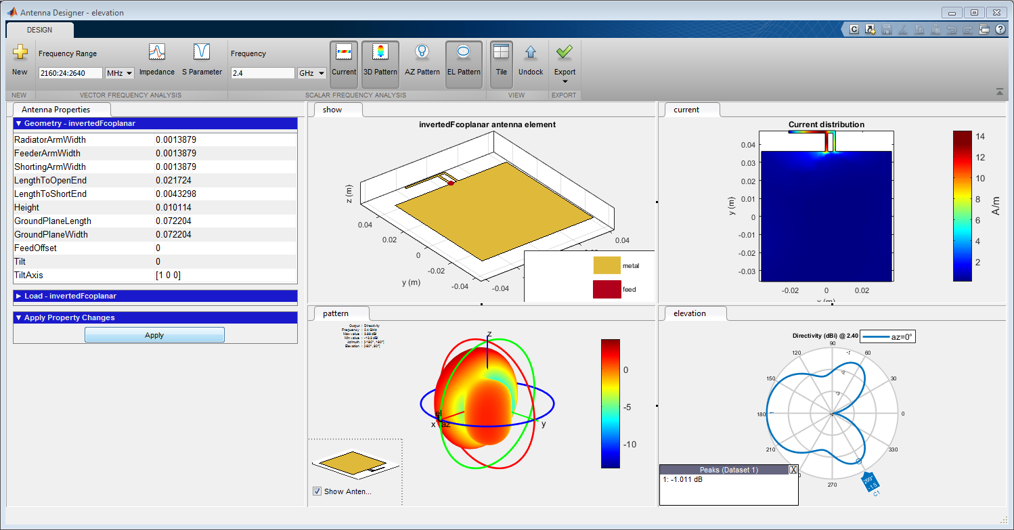
Antenna Design – Where To Start?
Antenna Designer / Array Designer / PCB Antenna Designer Apps
Select an antenna/array based on the desired specifications
Design the antenna at the operating frequency
Visualize results and iterate on antenna geometrical properties
Generate MATLAB scripts for automation
Notes:
When ew developed Antenna Toolbox, we had 1 objective in mind: make Antenna design and analysis easy for the non-EM expert.
While making complex things possible for the experts.
$$F_{total}=F_{1}+\frac{F_{2}−1}{G_{1}}+ \frac{F_{3}−1}{G_{1}G_{2}}+\frac{F_{4}−1}{G_{1}G_{2}G_{3}}+ …+\frac{F_{n}−1}{G_{1}G_{2}{…G}_{n−1}}$$
$$\frac{1}{{OIPN}_{total}}=\frac{1}{{OIPN}_{1}}+ \frac{G_{2}}{{OIPN}_{2}}+\frac{G_{2}G_{3}}{{OIPN}_{3}}$$

Slide 29
Exercise 2

Slide 30











Antennas Recently Added to the Catalog
Cylindrical DRA
Fractal snowflake
Egg Crate Vivaldi
Elliptical patch
Rectangular DRA
Ridged waveguide
Antipodal Vivaldi
Monocone
Vivaldi offset cavity
Corrugated horn
Tapered LPDA

Slide 31



Antenna Electromagnetic Analysis
Full-wave solver: Method of Moments
Analysis-driven automatic mesh generation: triangles for surface, tetrahedra for volume
Manual control on meshing for advanced use cases
Support of dielectric and metal materials
Validated against state-of-the-art results
Notes:
RF PCB Toolbox uses the method of moments to analyze the PCB structure.
The structure will be automatically meshed: triangles for the metal surfaces, and tetrahedra for the dielectric volume.
You have the ability to manually control the maximum, minimum edges of the mesh, as well as the growth rate from minimum to maximum.
With the MoM you can compute S-parameters, impedance (inductance and capacitance), as well as charge and current distribution.
If you design PCB antennas and you are interested in the far and near field performance, you can use Antenna Toolbox.
With the method of moments, you can take into account the impact of the material properties, such as dielectric losses and metal conductivity.
Results have been validated against state-of-the-art publications and measurements.

Slide 32



Integration with Full-Wave EM Analysis for Antenna Design
Explicit modelling of polarization
Modeling of impedance, bandwidth, and frequency-dependent far-field radiation pattern

Slide 33
Behind the Scenes: Integrate Antenna Array Modeling in RF Simulation
Instantaneous voltage excitation to compute radiation pattern
Incident plane wave excitation to compute feed currents
I_{TX}
I_{RX}
V_{TX}
TX Array
S-parameters
RX Array
S-parameters
V_{RX}
TX_{signal} (EIRP)
RX_{signal}
S_{array}
S_{array}
Antenna Toolbox array object or measured antenna object
Embedded element pattern used to compute the full-array pattern
Frequency dependent modeling of S-parameters and pattern
Multicarrier signals
Polarization effects
Direction of arrival and departure
TX / RX configuration
Center frequency of (multicarrier) signals
Direction of arrival /departure

Slide 34


Measured Antenna Object
Import antenna data from measurements or 3rd party EM tools
S-parameters
E-field, embedded element
Integrate object into RF simulation and reflector analysis
P: No. of observation points
F: No. of frequency points
N: Number of ports
E: P X 3 X F
Direction: P X 3
embedded: P X 3 X F X N
Sparameters: sparameters object

Slide 35





Coupling in Antenna Arrays: Near and Far Field Effects
S-parameters model near-field leakage in between elements
Patterns of elements embedded within an array differ from the isolated element
RF Transmitter
Embedded element #8
S-parameters
Embedded element #1

Slide 36




Impact of Coupling on the Antenna Array Pattern
Without coupling
With coupling

Slide 37



Impact of Coupling on Beamforming Algorithms
Example: beam and null steering for interferer mitigation
Null at 45deg from boresight
Beam at 15deg from boresight
Without coupling
Attenuation = 16.3+51.6 = 67.9dB
With coupling
Attenuation = 16.2+16.8 = 33dB

Slide 38
Interfering Signals and Wideband Receivers
Is the interfering signal in-band or out-of-band?
Does it cause saturation and desensitization?
Can it be filtered out?
Can null-steering remove it?
CF₁
Desired signal:
Power, PAPR
Center frequency
Bandwidth
Direction
BW₁
Interfering signal:
Power, PAPR
Center frequency
Bandwidth
Direction
CF₂
~
~
~
BW₂

Slide 39






Out-of-Band Interfering Signal
Image rejection filter
F_{LO}
Finite isolation
20GHz
28GHz
3GPP FR2 TM3.1
Desired signal @27GHz
Az El = [60 0]
Power = -70dBm
F_{IN} = 27GHz
F_{IF_INTERF} = 4GHz
~
~
F_{INTERF} = 19GHz
~
F_{IF} = 4GHz
F_{LO} = 23GHz
OFDM 100MHz BW
Interferer @19GHz (image frequency)
Az El = [40 0]
Power = -70dBm

Slide 40




Out-of-Band Interfering Signal
3GPP FR2 TM3.1
Desired signal @27GHz
Az El = [60 0]
Power = -70dBm
OFDM 100MHz BW
Interferer @19GHz (image frequency)
Az El = [40 0]
Power = -70dBm
RMS EVM = 3.6%
With interfering signal RMS EVM = 4.2%

Slide 41



How Can AI Help?
Antenna design optimization
Use surrogate model assisted differential evolution for antenna synthesis (SADEA)
Use on optimization problems that are expensive to evaluate
Does not rely on gradients: works on smooth and nonsmooth problems
3D Pattern reconstruction
Use deep learning to reconstruct a 3-D antenna radiation pattern from two orthogonal 2-D slices
Reduce the time required for measurement or EM analysis of 3D patterns
Achieve more accurate interpolation than using analytical methods
https://www.mathworks.com/help/antenna/ug/antenna-optimization-algorithm.html
https://www.mathworks.com/help/antenna/ug/reconstruct-3d-pattern-from-2d-slices-using-deep-learning.html

Slide 42
Part 3: Integrating Dispersive Components

Slide 43


Exercise 3 and 4: Antenna Integration and Importing S-Parameters
1. Planar component analysis
2. RF architectural model
3. System integration:
impedance, coupling, dispersion

Slide 44





S-Parameters Analysis with RF Toolbox
Import, visualize, and export Touchstone files
Manipulate and analyze networks of RF components, including N-port S-parameters
Represent frequency-domain data using rational fitting for time-domain simulation

Slide 45

What is Rational Fitting?
Equivalent expression given by a ratio of two polynomial functions
Laplace domain model providing a state-space representation
Equivalent to a pole-zero description of S-parameters
Suitable for time-domain simulation (e.g. Spice-like, or RF Blockset circuit envelope)
Benefits:
Simple model for given accuracy: model order reduction avoids overfitting of measurement noise
Causal by construction: suitable for data interpolation/extrapolation and pulse response analysis
Residues
Time delay
$$f\left(s\right)=\left(\sum_{k=1}^{N}{\frac{C_{k}}{s−A_{k}}+D}\right)e^{−st_{d}}$$
Direct feedthrough
(value at ∞ frequency)
Poles

Slide 46






















RF PCB Components
Notes:
This is a current snapshot of the RF PCB components that you will find in RF PCB Toolbox.
You can find the complete list here: https://www.mathworks.com/help/rfpcb/pcb-components-catalog.html

Slide 47
Exercise 3

Slide 48



Electromagnetic Analysis of PCB Structures
Full-wave solver: Method of Moments
Volumetric mesh of the PCB
Analysis-driven automatic mesh generation
Manual control on meshing
Specify material properties: metal and dielectric

Slide 49








Sources of Dispersion and Impedance Mismatches
Amplifiers
Power amplifiers memory effects
Antennas impedance and pattern
Passive distributed elements

Slide 50


Dispersion Affects Broadband Signals
Output: frequency dependent gain
Input: white noise
Frequency dependent gain:
Amplitude and phase

Slide 51



Dispersion Requires Equalizer Compensation / Calibration
Example: OFDM 100MHz Bandwidth modulated input signal
Without equalizer
With equalizer
1024 carriers
120kHz spacing
122.88MHz bandwidth
Baseband receiver
Automatic gain control
Static phase equalizer
Notes:
As the signal bandwidth is large the frequency response is not flat. This must be compensated.
In particular, gain flatness is ok, but there is an almost constant group delay leading to a 30degrees phase rotation over the 100MHz signal bandwidth.
If the TX is not equalized, a simple receiver will have a degraded EVM.
The equalizer in reality will not be in RX, but will be part of the TX, and it is essentially providing static calibration of the TX frequency dispersion.
As it is linear it can be moved in the TX chain with consistent results.

Slide 52
Conclusions
We use a practical example to understand the basics of analysis and simulation technology
Analyze the RF budget of a receiver starting from high-level specifications
Integrate the antenna and simulate the impact of interfering signals and polarization mismatch
Design a dual polarized antenna and its feed network on a PCB and integrate it in the receiver
What we learned:
Validate results using different RF analysis tools: Friis, Harmonic Balance, Circuit Envelope
Integrate datasheet specifications and measured data to improve modeling fidelity
Create executable RF models including: dispersion, impedance mismatches, coupling, polarization, non-linearity, noise, interferers

Slide 53
Extra: Modeling and Linearization of Power Amplifiers

Slide 54
PA Linearization: Digital Pre-Distortion (DPD) in Theory
DPD
PA
PA characteristic
(actual)
Linear characteristic
(desired)
Pout [dBm]
Compression
DPD characteristic
Pin [dBm]
Notes:
Let’s take a step back, and see how Digital Pre Distortion can be used to increase the transmitters linearity. The principle is simple: the Power Amplifier introduces non linearity, here described by a compressing characteristic in orange.
<click>
However, the desired TX characteristics should be linear, such as the black curve.
<click>
For this reason, we introduce a digital algorithm (Digital Pre Distortion) before the PA that pre-distorts the signal …
<click>
The DPD characteristic is the inverse of the one of the PA. The overall behaviour is linear even if both the elements are non-linear because their characteristics cancel each other.

Slide 55
PA Linearization: Digital Pre-Distortion (DPD) in Practice
Baseband
Up-conversion
DPD
PA
RF
Antenna loading
Adaptive coefficients
Timing
Down-conversion
PA characteristic
(actual)
Pout [dBm]
Compression
Memory
DPD characteristic
Pin [dBm]
Notes:
If the theory is simple, the practice of designing and implementing a DPD algorithm is far more complex.
First, the PA is not only non-linear, but it is also affected by memory. The output of the PA at a certain point in time also depends on the values of the input signal in the past. This means that the PA behaviour depends on the type of modulation, bandwidth, power, Peak to Average Power Ratio and other characteristics of the input signal.
For this reason, the DPD algorithm should be adaptive and has to operate in a closed feedback-loop configuration, to compensate for the PA effects.
To make things even more complex, DPD algorithms are digital algorithms implemented in baseband, while PAs are RF components operating at high-frequency. This means that up-conversion and down-conversion stages are required to make the two systems operate together.
All the low-power analog and RF components include imperfections that need to be considered as they will affect the DPD behaviour. Timing imperfections are important as they might make the system unstable. Other aspects that cannot be neglected are, for example, the loading effects of the antenna on the PA, or the DPD strategy to adaptively compute the corrections coefficients.

Slide 56



Fitting Memory Polynomial Series with MATLAB
Simple, fast, customizable fitting procedure to model memory and non-linearity
Based on I/Q (time domain, wideband) measurement data from your PA
Generalized model including memory lead and lag terms with a causal response implementation
Memory length
Degree of non-linearity
Order →
Memory
length →
Notes:
MATLAB can effectively help you in more easily identifying a PA model based on a generalized memory polynomial series as described in this IEEE paper from Dennis Morgan and others. The idea is straightforward: use input/output complex (I,Q – in phase and quadrature) characteristics of the PA to extract the coefficient matrix “a” describing the model.
<click>
M represents the memory depth.
<click>
K the degree of non-linearity.
This approach can also be used to describe purely static characteristics such as AM-AM/AM-PM, by setting the memory depth equal to 1.

Slide 57



Using 3GPP Standard Signals
Reference BB transmitter
FR2 TM1.1
Reference BB receiver
FR2 TM1.1
inWaveform
rfsystem
outWaveform
RF Transmitter model

Slide 58



Testing Transmitter Linearization
No DPD EVM RMS = 3.4797%
No DPD ACPR = 37dBc
With DPD ACPR = 45dBc
With DPD EVM RMS = 0.44591%

Slide 59







Testing Transmitter Emissions
EIRP 15deg @27GHz
F_{IN} = 4GHz
F_{OUT} = 27GHz
LO leakage (60dBc)
F_{LO} = 23GHz
EIRP -15deg @23GHz
Beamforming at 15deg
from boresight

Slide 60

How Can AI Help?
AI for Digital Predistortion Design
Model, train, and test the following neural network architectures:
Augmented real-valued time-delay neural network (ARVTDNN)
Long short-term memory neural network LSTMNN)
Bidirectional LSTM neural network (BiLSTMNN)
Gated recurrent unit neural network (GRUNN)
Structurally compress neural network DPD: reduce computational complexity and memory requirements by using projection and principal component analysis
https://www.mathworks.com/help/comm/ug/ai-for-digital-predistortion-design.html
https://www.mathworks.com/help/comm/ug/power-amplifier-modeling-using-neural-networks.html

